Slide 1
OMR Scanning using opencv
Team Members-
Kedar Swami B-58
Siddhant Toggi B-61
Yashraj Vibhute B-65
Project guide
Prof S.S. More

Slide 2
AGENDA
Introduction​
Primary goals
Implementation and Tech
​Summary​

Slide 3
Introduction
Use of OpenCV module in Python for OMR Sheet Scanning
Money Efficient
Portable
Easy Availability and Usage
Fast and Efficient

Slide 4
PRIMARY GOALS

Slide 5
OMR scanning through OpenCV offers several advantages over traditional OMR systems, including greater accuracy in mark detection, faster processing time, and the ability to handle more complex forms with varying mark types and layouts. Additionally, OpenCV is an open-source library, making it cost-effective and customizable for specific OMR scanning needs.
We have a possibility that our application would do the following activities:
Automatically checks the answer sheet in the photo,
Detect responses for each question and
Compare student responses with reference answers.

Slide 6
Implementation and Tech

Slide 7
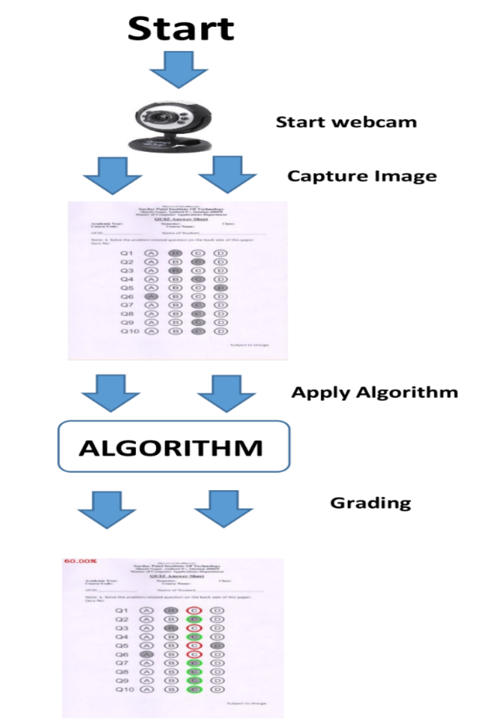
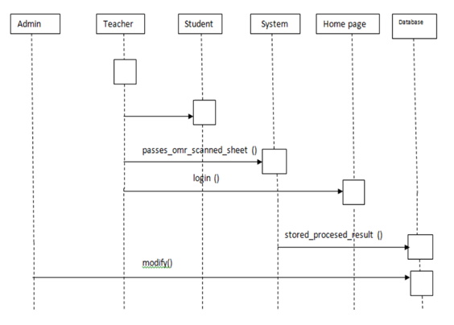
This System is programmed using python and some native libraries. The system can be deployed on any operating system since the whole system will be done in python (platform independent). Aimed at the drawbacks of traditional OMR, our system will have Image tilts correction to improve the recognition precision and Easy Scanning Availability.

Slide 8
SUMMARY
For detection of images, tiff images are used which are very memory consuming, but tiff images give better image quality and its detections. So in future, we can make use of less memory images which help to reduce memory wastage.
If this system is implemented successfully, the teachers of colleges will be capable of designing attendance sheets by themselves and the supervisor of colleges can adopt this technique to investigate the students attendance as well as their attention towards studies easily and quickly.

Slide 9
THANK YOU

